Slide 1

LVP Granite Fund
NAV per unit
$1.1693
Monthly Factsheet · June 2026
Inception
1 June 2026
Wholesale investors only
APIR
LVP0221AU
A strong start: the Fund delivered a +16.93% net return in its first month, driven by the FPACA seed acquisition completed at first close.
Performance (net of fees)
+16.93%
+16.93%
n.m.¹
$1.1693
June 2026
Since inception
Ann. since inception
NAV per unit
Monthly performance (net) - FY2026
 | JUL | AUG | SEP | OCT | NOV | DEC | JAN | FEB | MAR | APR | MAY | JUN | Total
Total return | - | - | - | - | - | - | - | - | - | - | - | 16.93% | 16.93%
Distribution | - | - | - | - | - | - | - | - | - | - | - | - | -
Fund commenced 1 June 2026; prior months are pre-inception. Returns are net of fees and any accrued performance fee.
Manager commentary
We are pleased to present the inaugural monthly report for the LVP Granite Fund, following the Fund’s launch on 1 June 2026. Granite is a private markets vehicle with a real-assets core, designed to combine capital growth with a meaningful yield component. The strategy seeks to build a portfolio with strong defensive characteristics while also pursuing strong risk-adjusted returns.
In its first month, the Fund deployed approximately 90% of first-close proceeds into the For Purpose Aged Care Australia (“FPACA”) seed asset. Reflecting the economics of the seed transaction, the Fund recognised a month-1 uplift on the acquired asset and delivered a net return of 16.93% for June - an outcome we were pleased to see land above the expectations set for first close.
FPACA is an established residential aged-care platform operating within a regulated, government-supported framework. We retain strong conviction in the quality of the asset and its risk-adjusted return characteristics, underpinned by a defensive, income-generating profile and strong asset backing.
The Fund will also benefit from a well-developed pipeline. Under the agreed seed transaction, Granite has access to two further seed assets - a sustainable-seafood (natural capital) strategy and a disability-accommodation portfolio - alongside a growing new-deal pipeline, including opportunities across regional data centres, natural capital royalties and a sustainable coastal infrastructure opportunity.
As the portfolio scales, we intend to layer in further investments in a measured way, building diversification across assets, sectors and thematics over time, while preserving the Fund’s yield and capital-growth objectives. We thank our first-close investors for their support and look forward to updating you as the strategy develops.
¹ Not meaningful over a period of less than 12 months; the June return reflects a one-off Day-1 transaction uplift and should not be annualised.
Strictly private & confidential · For wholesale investors only
Page 1 of 2

Slide 2
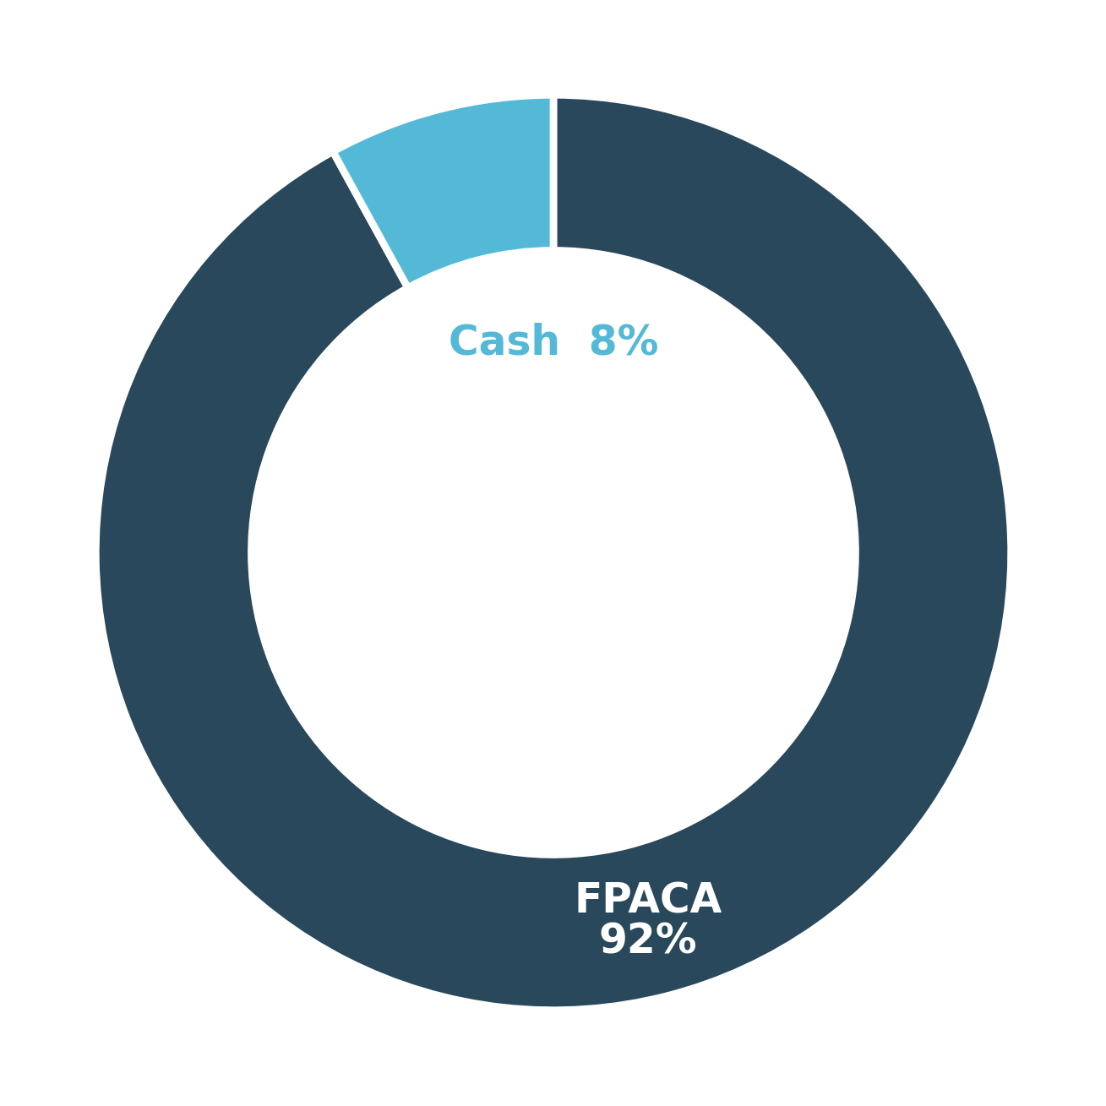
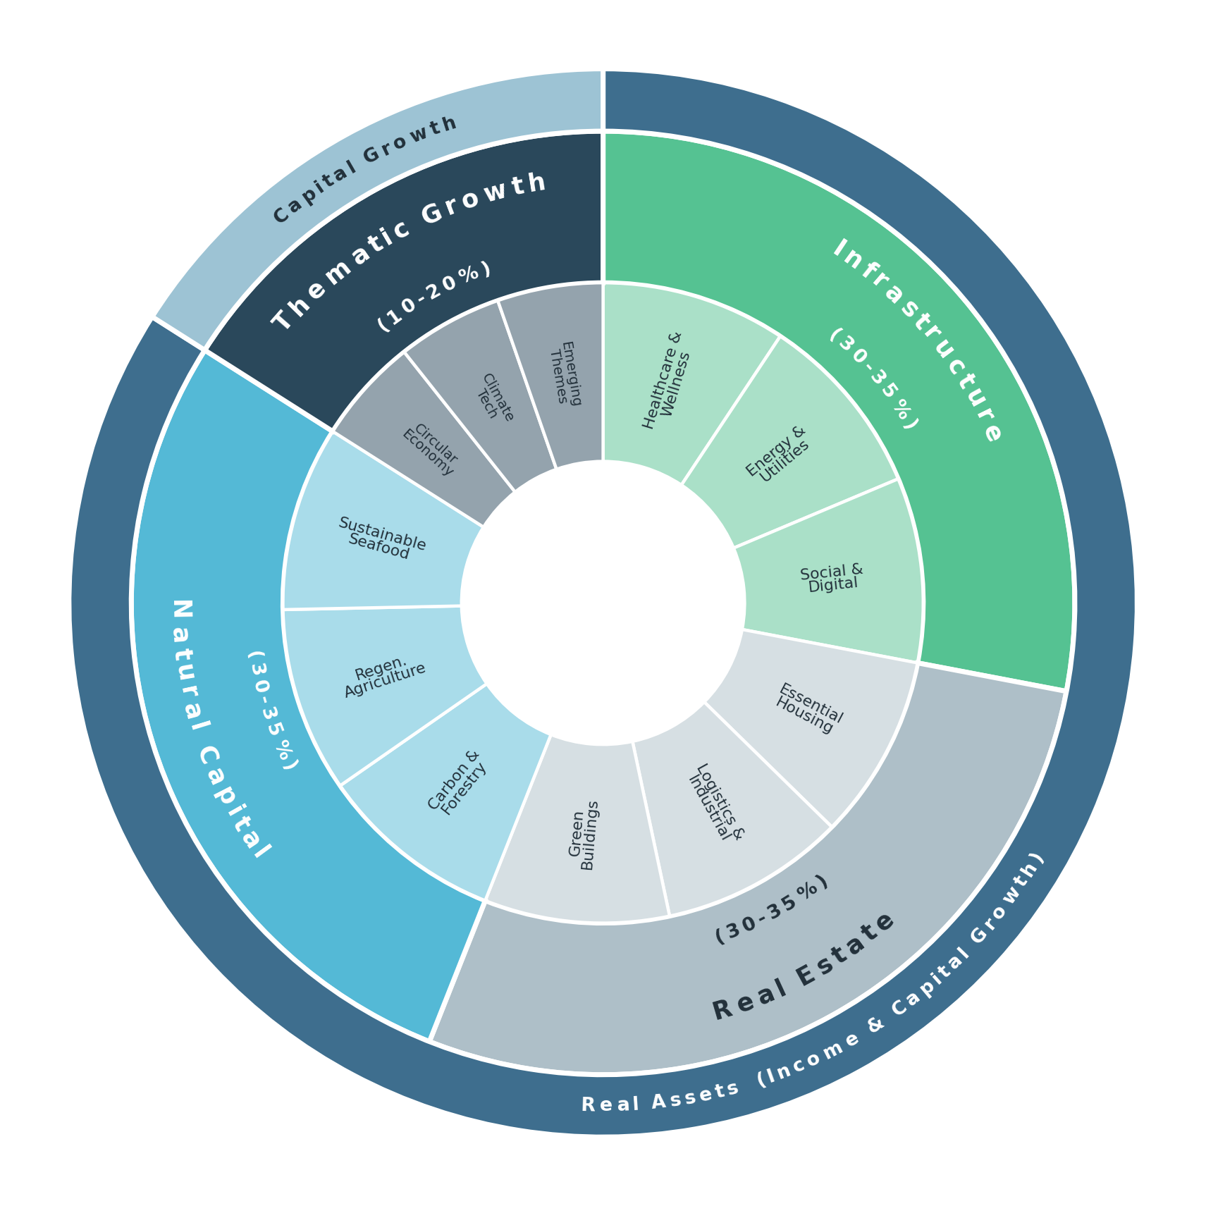
LVP Granite Fund
NAV per unit
$1.1693
Monthly Factsheet · June 2026
Inception
1 June 2026
Wholesale investors only
APIR
LVP0221AU
Portfolio holdings
Holding | Profile | Asset Class | Sector | % NAV
FPACA | Yielding + growth | Infrastructure | Aged Care | ~92%
Cash & equivalents | - | Cash | - | ~8%
Total |  |  |  | 100%
Portfolio construction
Actual (NAV)
Indicative
Fund terms
Investment objective | 12-15% p.a. total return with 5-8% yield (target only²)
Structure | Open-ended, semi-liquid · Australian unit trust
Applications | Monthly
Redemptions | Monthly (5% quarterly cap) with 24-month lock-up
Distributions | Quarterly
Min. investment | A$25,000 (direct) / platform-set
Management fee | 1.50% p.a. (ex-GST)
Performance fee | 12.5% (ex-GST) over an 8% hurdle
Eligible investors | Wholesale clients only
Inception / APIR | 1 June 2026 · LVP0221AU
² Target return is an objective only, not a forecast, projection or guarantee of future performance. Indicative construction is illustrative only and subject to change; it converts to actual portfolio allocation as the portfolio scales.
Important information: This information has been prepared by Liverpool Partners Pty Ltd (ACN 159 465 193; AFSL 429777) ("LVP", "we" or "our") for wholesale clients only, as defined in the Corporations Act 2001 (Cth) ("Corporations Act"). Investors should refer to the Information Memorandum (including any supplements to the Information Memorandum from time to time) for the LVP Granite Fund ("Fund") and seek professional advice before making any decisions in relation to the Fund. Figures referred to in this document are unaudited. No member of the LVP Group makes any representations or warranties, express or implied, regarding the accuracy, reliability, or completeness of the information in this document or guarantees repayment of capital or any rate of return from the Fund. Nothing contained in this document should be considered a promise or representation regarding past or future performance. Past performance is not indicative of future results. This information is provided in summary form and is not intended to be comprehensive. It should not be considered financial advice or a recommendation to invest, hold, or sell units in the Fund. This document does not take into account individual investment objectives, financial situations, or needs. Before making any investment decision, investors should consider the relevance of this information in light of their own circumstances, review the relevant Information Memorandum (including any supplements thereto from time to time) and seek independent financial advice. The views and opinions expressed here are for informational purposes only and do not constitute a recommendation by any member of the LVP Group to buy, sell or hold any security. They reflect the current perspective as of the document's date and may be subject to change. This should not be construed as investment advice. For the purposes of this document, "LVP Group" means LVP and any related body corporate or associate of LVP (as defined under the Corporations Act) and any partnership, trust or investment vehicle managed or advised by LVP or any of its related bodies corporate or associates (as applicable).
Strictly private & confidential · For wholesale investors only
Page 2 of 2

